Slide 1
COVID-19 Phylogeny
Aman Patel

Slide 2
What is Phylogeny?
The study of the evolutionary history of biological entities
Used to show evolutionary relationships between different organisms
Often used in bioinformatics and epidemiology to gain insight on the history of a pathogen and/or an outbreak
In this case, the phylogeny of COVID-19 can be used to evaluate the source of the outbreak and how the virus has evolved since its emergence

Slide 3
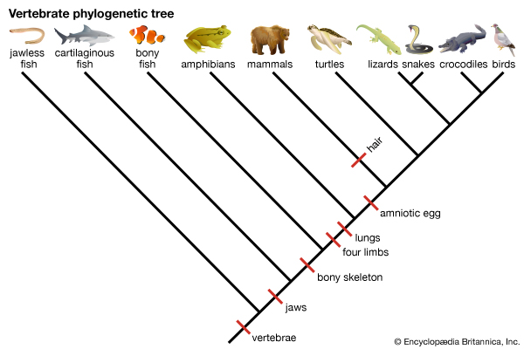
Building a Phylogenetic Tree
I will be implementing the following set of algorithms:
Multiple Sequence Alignment
Distance Matrix Creation
UPGMA
Figure 1: Vertebrate Phylogenetic Tree

Slide 4
Multiple Sequence Alignment
Creates the alignment that minimizes the total score of the alignment
Scoring systems have a variety of gap penalties
Constant
Same score regardless of length
Linear
Larger gaps result in worse score
Affine
Increased penalty for starting a gap and larger gaps result in worse score

Slide 5
Creating a Distance Matrix
Given a multiple alignment, a distance matrix can be found via a nested iteration
For each sequence in the alignment, calculate the score between the sequence and all other sequences using the selected scoring system
Insert all values into an array where array[i,j] is the score of the alignment for sequences i and j

Slide 6
UPGMA
Unweighted pair group method with arithmetic mean
Used to construct a phylogenetic tree from a distance matrix
Simple and fast relative to other phylogenetic tree constructing algorithms, such as the neighbor-joining algorithm
May produce unreliable results, as the algorithm assumes equal rates of evolution
Algorithm was discussed in lecture

Slide 7
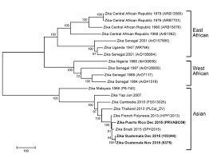
Interpreting the Results
Gives insight into when and how a mutation in the virus occurred
Can provide information on the method of transmission
Show the rate of evolution and the direction of evolution of the virus
Can be used to predict the spread of the virus
Figure 2: Phylogenetic Tree of the Zika Virus

Slide 8
Works Cited
Ciccozzi, M., Lai, A., Zehender, G., Borsetti, A., Cella, E., Ciotti, M., . . . Angeletti, S. (2019, July 12). The phylogenetic approach for viral infectious disease evolution and epidemiology: An updating review. Retrieved December 9, 2020, from https://onlinelibrary.wiley.com/doi/abs/10.1002/jmv.25526
Construction of a distance tree using clustering with the Unweighted Pair Group Method with Arithmatic Mean (UPGMA). (n.d.). Retrieved December 9, 2020, from https://www.icp.ucl.ac.be/~opperd/private/upgma.html
Embl-Ebi. (n.d.). Multiple Sequence Alignment. Retrieved December 10, 2020, from https://www.ebi.ac.uk/Tools/msa/
Figure - Phylogeny of Zika Virus in Western Hemisphere, 2015 - Volume 22, Number 5-May 2016 - Emerging Infectious Diseases journal - CDC. (n.d.). Retrieved December 9, 2020, from https://wwwnc.cdc.gov/eid/article/22/5/16-0065-f1
Phylogenetic Tree: Vertebrates. (n.d.). Retrieved December 9, 2020, from https://kids.britannica.com/students/assembly/view/235364
Severe acute respiratory syndrome coronavirus 2 data hub. (n.d.). Retrieved December 9, 2020, from https://www.ncbi.nlm.nih.gov/labs/virus/vssi/

